Slide 1

MALAYALAM CHARACTER RECOGNITION
MAIN PROJECT
Department Of MCA, MES College Of Engineering,Kuttippuram
DEPARTMENT OF COMPUTER APPLICATION

Slide 2
PREPARED BY
NIHAD ABDULLA V A(MES21MCA-2036)
GUIDED BY
MUHAMMAD JABIR C
ASSISTANT PROFESSOR
MASTER OF COMPUTER APPLICATIONS
MES COLLEGE OF ENGINEERING, KUTTIPPURAM
DEPARTMENT OF COMPUTER APPLICATION

Slide 3
CONTENTS
Introduction
Existing System
Proposed System
Developing Environment
DFD
User Stories
Product Backlog
Project Plan
Sprint Plans
DEPARTMENT OF COMPUTER APPLICATION

Slide 4
INTRODUCTION
Malayalam character recognition is a field of study and development aimed at creating systems capable of accurately identifying and processing the characters used in the Malayalam language. This involves creating algorithms and models that can identify the unique shapes and patterns of individual characters and distinguish them from one another. Such systems have a wide range of applications, including optical character recognition (OCR) for digital documents, font recognition for typography, and for digital ink. The goal of Malayalam character recognition is to produce accurate and efficient recognition systems that can be integrated into a variety of applications and devices
DEPARTMENT OF COMPUTER APPLICATION

Slide 5
EXISTING SYSTEM
Jathakam is a commercial software for Malayalam character recognition that is commonly used for digitizing handwritten Malayalam documents. The software uses a combination of image processing, machine learning, and language modeling techniques to recognize characters with high accuracy.
Malayalam OCR is an open-source project that provides a set of tools for recognizing printed Malayalam text from scanned images. The system uses a combination of segmentation, feature extraction, and machine learning techniques to recognize characters and words with high accuracy.
DEPARTMENT OF COMPUTER APPLICATION

Slide 6
PROPOSED SYSTEM
Malayalam Character Recognition is a machine learning project that aims to accurately recognize individual characters in the Malayalam alphabet. The project uses computer vision techniques and deep learning algorithms to process digital images of handwritten or printed characters, and then outputs the corresponding Malayalam character. The recognition process involves pre-processing the input image, extracting features, training a model, and testing the model for accuracy. The goal of the project is to build a model that is able to recognize a wide range of Malayalam characters with high accuracy, making it useful for various applications such as handwriting recognition, optical character recognition, and document analysis..
DEPARTMENT OF COMPUTER APPLICATION

Slide 7
DEVELOPMENT ENVIRONMENT
SOFTWARE REQUIREMENTS
Image processing software such as OpenCV or scikit-image for preprocessing images.
Machine learning libraries such as TensorFlow, PyTorch, or scikit-learn for building and training the recognition model.
Text processing software for post-processing the recognition results.
DEPARTMENT OF COMPUTER APPLICATION

Slide 8
HARDWARE SPECIFICATION
A computer with sufficient processing power to handle the image processing and machine learning tasks.
A scanner or digital camera for capturing input images.
Optional: specialized hardware such as graphics processing units (GPUs) or tensor processing units (TPUs) to speed up machine learning computations.
DEPARTMENT OF COMPUTER APPLICATION

Slide 9


Slide 10
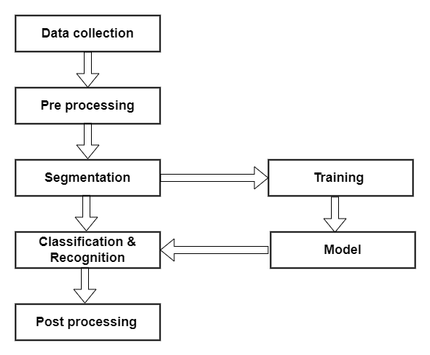

Slide 11
USER STORIES
UserStory_ID | As a <type of user | I want to | So that I can
1 | Data collection | Collection | Preparing dataset
2 | Pre processing | Binarizing | Removing the noise ,normalizing , converting to gray scale
3 | Segmentation | Segmentation | Word segmentation , character segmentation
4 | Classification | Classification | Classify the extracted features into different character classes.
5 | Post processing | Post processing | Correct errors, recognize whole words, and verify the results.
DEPARTMENT OF COMPUTER APPLICATION

Slide 12
PRODUCT BACKLOG
ID | PRIORITY | SIZE (HRS) | SPRINT | STATUS | NAME
1 | Medium | 7 | 1 | Completed | Data collection
2 | Medium | 5 |  | Completed | Pre processing
3 | High | 8 | 2 | Progress | Segmentation
 |  |  |  | Planned | Feature extraction
4 | High | 10
5 | Medium | 10 | 3 | Planned | Classification
6 | High | 10 |  | Planned | Post processing
DEPARTMENT OF COMPUTER APPLICATION

Slide 13
PROJECT PLAN
USERSTORY_ID | SPRINT | START DATE | END DATE | DAY | STATUS
1 | Sprint 1 | 07/02/2023 | 28/02/2023 | 21 | Completed
2
3 | Sprint 2 | 01/03/2023 | 15/03/2023 | 15 | Completed
4
5 | Sprint 3 | 17/04/2023 | 15/05/2023 | 29 | Planned
6 |  |  |  | 18
DEPARTMENT OF COMPUTER APPLICATION

Slide 14
SPRINT 1
Backlog item | Status and completion date | ORIGINAL ESTIMATE | DAY 1 07/02/23 | DAY 2 08/02/23 | DAY 3 09/02/23 | DAY 4 10/02/23 | DAY 5 13/02/23 | DAY 6 14/02/23 | DAY 7 15/02/23 | DAY 8 16/02/23 | DAY 9 17/02/23 | DAY 10 20/02/23 | DAY 11 21/02/23 | DAY 12 22/02/23 | DAY 13 23/02/23 | DAY 14 24/02/23 | DAY 15 27/02/23 | DAY 16 28/02/23
USER STORY #1 |  | HRS | HRS | HRS | HRS | HRS | HRS | HRS | HRS | HRS | HRS | HRS | HRS | HRS | HRS | HRS | HRS | HRS
Data collection | 10/02/23 | 2 | 1 | 0 | 1 | 0 | 0 | 0 | 0 | 0 | 0 | 0 | 0 | 0 | 0 | 0 | 0 | 0
Pre processing | 17/02/23 | 6 | 0 | 0 | 0 | 0 | 1 | 2 | 1 | 2 | 0 | 0 | 0 | 0 | 0 | 0 | 0 | 0
Segmentation | 22/02/23 | 2 | 0 | 0 | 0 | 0 | 0 | 0 | 0 | 0 | 0 | 0 | 0 | 0 | 0 | 0 | 0 | 0
Classification& recognition | 28/02/23 | 2 | 0 | 0 | 0 | 0 | 0 | 0 | 0 | 0 | 0 | 0 | 0 | 0 | 0 | 0 | 0 | 0
Total |  | 12 | 1 | 0 | 1 | 0 | 1 | 2 | 1 | 2 | 0 | 0 | 0 | 0 | 0 | 0 | 0 | 0

Slide 15
SPRINT 2
Backlog item | Status and completion date | ORIGINAL ESTIMATE | DAY 1 07/02/23 | DAY 2 08/02/23 | DAY 3 09/02/23 | DAY 4 10/02/23 | DAY 5 13/02/23 | DAY 6 14/02/23 | DAY 7 15/02/23 | DAY 8 16/02/23 | DAY 9 17/02/23 | DAY 10 20/02/23 | DAY 11 21/02/23 | DAY 12 22/02/23 | DAY 13 23/02/23 | DAY 14 24/02/23 | DAY 15 27/02/23 | DAY 16 28/02/23
USER STORY #1 |  | HRS | HRS | HRS | HRS | HRS | HRS | HRS | HRS | HRS | HRS | HRS | HRS | HRS | HRS | HRS | HRS | HRS
Data collection | 01/03/23 | 2 | 1 | 0 | 1 | 0 | 0 | 0 | 0 | 0 | 0 | 0 | 0 | 0 | 0 | 0 | 0 | 0
Pre processing | 10/03/23 | 6 | 0 | 0 | 0 | 0 | 1 | 2 | 1 | 2 | 0 | 0 | 0 | 0 | 0 | 0 | 0 | 0
Segmentation | 13/03/23 | 2 | 0 | 0 | 0 | 0 | 0 | 0 | 0 | 0 | 0 | 0 | 0 | 1 | 0 | 1 | 0 | 0
Classification & recognition | 15/03/23 | 2 | 0 | 0 | 0 | 0 | 0 | 0 | 0 | 0 | 0 | 0 | 0 | 0 | 0 | 0 | 0 | 0
Total |  | 12 | 1 | 0 | 1 | 0 | 1 | 2 | 1 | 2 | 0 | 0 | 0 | 1 | 0 | 1 | 0 | 0

Slide 16
Thank You…
DEPARTMENT OF COMPUTER APPLICATION

